Slide 1
A Crash Course in Version Control and Git
Warren Frame

Slide 2




Agenda
Notes:
PowerPoint
GitHub site and Windows Client
Git from the command line
Just a quick heads up, all the materials including my notes for this presentation will be posted on GitHub following this presentation, including pretty much all of the URLs and references I mention
If you don’t mind, I’ve asked Nick to hold questions until the end, this will be a bit fast paced, and timing will be tight, but happy to answer questions afterwards,

Slide 3
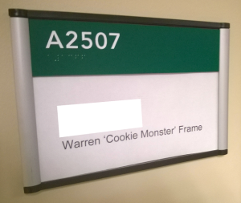
About Me
What do I do?
Sr. Systems Engineer, Rochester Regional Health
Design and build solutions, learn, share
Other Pursuits:
Science, Infosec
Tech, Cooking
Tennis, Family
Where to find me
 Twitter.com/PSCookieMonster
↑ LinkedIn.com/in/Wframe
 RamblingCookieMonster.github.io
 Github.com/RamblingCookieMonster
 PowerShell Slack Community
Notes:
Microsoft, VMware, Citrix, etc.
I'm on LinkedIn and Twitter, feel free to connect
Slack - Modern hosted chat service, it's bridged with the PowerShell channel on IRC and is quite handy:
I can ask questions and talented folks like Joel Bennet, Dave Wyatt, Kirk Munro, Justin Rich, and many others, including a few from the PowerShell team, might jump in to help.
I also find that trying to help others can help you learn a bit.
If your boss is asking 'why are you in a chatroom at work!' - turns out when you put a bunch of PowerShell folks in a chat room, some interesting ideas that you could take back to work and implement might come up. Or someone mentions an issue you're experiencing and how they fixed it. Very helpful!
slack.poshcode.org > submit your e-mail, join up!
Some fun Git-related posts:
Source Control Survey Results - http://ramblingcookiemonster.github.io/Source-Control-Survey/
GitHub for PowerShell Projects - http://ramblingcookiemonster.github.io/GitHub-For-PowerShell-Projects/
Fun with GitHub, Pester, and AppVeyor - http://ramblingcookiemonster.github.io/GitHub-Pester-AppVeyor/
GitHub, Pester, and AppVeyor: Part Two - http://ramblingcookiemonster.github.io/Github-Pester-AppVeyor-Part-2/
Testing DSC Configurations with Pester and AppVeyor - http://ramblingcookiemonster.github.io/Testing-DSC-with-Pester-and-AppVeyor/
A topic we won’t cover here, but GitHub pages are a great way to host your blog content, if you don’t mind a little yak shaving: http://ramblingcookiemonster.github.io/GitHub-Pages/

Slide 4

Goals
Use version control for your own projects
Foundation to contribute to Microsoft's DSC Resources on GitHub
Background to make a case to bring version control to your team at $Work
Become a Git Pro!
Notes:
User Version Control for your own projects…
Whether at home or at work
In case you missed it, Microsoft recently open sourced the DSC resources: https://github.com/PowerShell/DscResources
In the past, if you wanted to fix a bug or add a feature to Microsoft’s DSC resources, you would…
Write the code!
Microsoft updates the resource…
You merge in your changes or put off updating
Not sustainable.
Now:
Learn the basics of GitHub and Git
Submit a pull request
If accepted, your code will be included in all future updates!

Slide 5
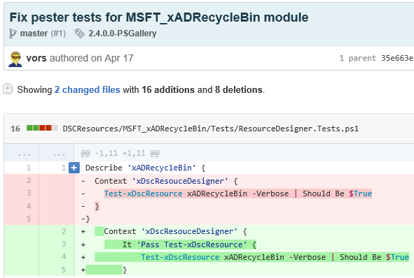
What is Version Control?
System to manage changes to files
Who vors
When April 17
What Files and differential
(Sometimes) Why To fix Pester tests
Why use it?
Revert to or review prior changes
Maintain multiple versions
Compare differences
Share and collaborate
Modern solutions might assume you have it!
Infrastructure-as-code
Continuous Integration and Delivery
Google around for many more reasons!
AKA Revision Control, Source Control
Notes:
Picture of a commit from the DSC resources on GitHub – a commit is just a snapshot of the project at one point in time
I’m going to make the assumption that you’ve seen the light and want to use version control, I don’t want to spend too much time on the importance of using this. I’ve included a few links in the notes. Long story short? It’s included in Tom Limoncelli’s Operations Report Card.
Plenty of examples on why you should use source control:
http://www.opsreportcard.com/section/6 – Because Tom said so : )
http://stackoverflow.com/questions/1408450/why-should-i-use-version-control
http://www.git-tower.com/learn/git/ebook/mac/basics/why-use-version-control
http://hgbook.red-bean.com/read/how-did-we-get-here.html
http://betterexplained.com/articles/a-visual-guide-to-version-control/
Not going into details, at work, we have a module used by a few teams.
When I push to this git repository, Jenkins can run some pester tests, and if all goes well, copy the module out to a network share that systems regularly update from.
Examples leveraging a popular continuous integration and delivery solution, Jenkins:
https://www.hodgkins.net.au/powershell/automating-with-jenkins-and-powershell-on-windows-part-1/ (Link to part 2 included)
http://www.dexterposh.com/2015/06/powershell-pester-jenkins-ci.html
Examples using GitHub:
http://ramblingcookiemonster.github.io/GitHub-For-PowerShell-Projects/#continuous-integration
http://powershell.org/wp/community-build-server/ - Thanks to Dave Wyatt, PowerShell.org, Chef, and anyone else behind this!

Slide 6
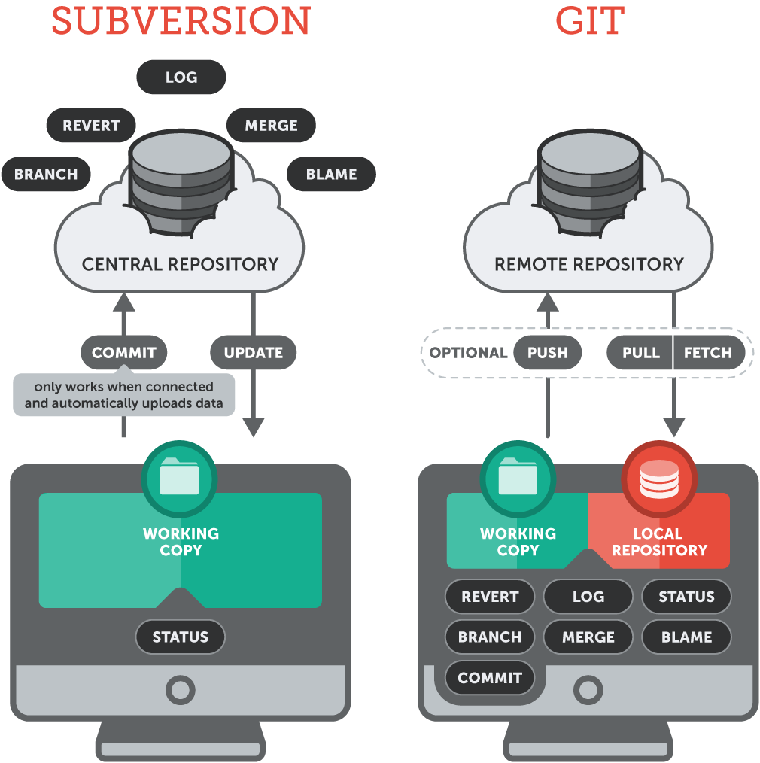
Version Control Systems
Centralized
Work directly against a central server
Subversion, CVS, Perforce, etc.
Distributed
Work locally, optionally push to remote repositories
Git, Mercurial (Hg), etc.
Hosted solutions
GitHub, BitBucket, Visual Studio Online, etc.
On-Premise solutions
GitHub Enterprise, Stash, Team Foundation Server, etc.
git-tower.com
Notes:
Git Google talk from Linus Torvalds https://www.youtube.com/watch?v=4XpnKHJAok8 – discusses some of the design goals for git, and why the centralized model isn’t a great fit - paraphrased, Linus is more explicit : )
Like anything, evaluate what fits your workflow and needs, but IMHO most new deployments likely warrant a distributed VCS
It’s important to note that the processes we’re walking through today could be applied to an on-premise solution like Atlassian Stash. There will be small operational differences, but many similarities.

Slide 7
Terminology
Nope nope nope

Slide 8
Exploring and Using GitHub
Demo!
Notes:
We’re going to jump into a demo with the GitHub for Windows client shortly, but keep in mind there are other options out there.
Atlassian’s SourceTree is fantastic and works with Mercurial as well. I tend to use this and the GitHub for Windows client. - https://www.sourcetreeapp.com/
TortoiseGit is another client you might hear about often - http://tortoisegit.org/

Slide 9
Command Line Git
Demo!

Slide 10
Further Reading
There’s a lot out there. Here are some highlights. Don’t be intimidated, you don’t need all this, but it may come in handy if you want to dive a bit deeper into the weeds. The key is starting to use it, just like PowerShell!
Interactive guides
GitHub’s interactive guide – Learn Git in 15 minutes: https://try.github.io/
Learn Git Branching: http://pcottle.github.io/learnGitBranching
Interactive Cheat sheet: http://ndpsoftware.com/git-cheatsheet.html
References
Official git reference: http://git-scm.com/docs
Pro Git (free!): http://www.git-scm.com/book/en/v2 - the first two or three chapters are a great intro
Understanding Branches: http://blog.thoughtram.io/git/rebase-book/2015/02/10/understanding-branches-in-git.html
Git Explained: For Beginners: http://www.dotnetcodegeeks.com/2015/06/git-explained-for-beginners.html
GitHub Flow – GitHub from a Browser: https://github.com/blog/1557-github-flow-in-the-browser
Contributing to Microsoft’s DSC Resources on GitHub
Guide to getting started with GitHub: https://github.com/PowerShell/DscResources/blob/master/GettingStartedWithGitHub.md
DSC Contributions guide: https://github.com/PowerShell/DscResources/blob/master/CONTRIBUTING.md
DSC Resource Style Guidelines: https://github.com/PowerShell/DscResources/blob/master/StyleGuidelines.md
More references
Pro Git (free!): http://www.git-scm.com/book/en/v2 - the rest of the book : )
A Visual Git Reference: http://marklodato.github.io/visual-git-guide/index-en.html
Git From the Inside Out: https://codewords.recurse.com/issues/two/git-from-the-inside-out
Git For Computer Scientists: http://eagain.net/articles/git-for-computer-scientists - Great read with pictures, don’t be intimidated by the title
Branching, forking, other concepts explained: http://stackoverflow.com/questions/3329943/git-branch-fork-fetch-merge-rebase-and-clone-what-are-the-differences
Oh shoot, something went wrong!
So you have a mess on your hands workflow: http://justinhileman.info/article/git-pretty/git-pretty.png
How to undo (almost) anything with Git: https://github.com/blog/2019-how-to-undo-almost-anything-with-git
A few recent articles:
Git Disciplined: http://blog.8thlight.com/makis-otman/2015/07/08/git-disciplined.html - Thanks for sharing Steve!
Git for IT Professionals: Getting Started: http://www.powershellmagazine.com/2015/07/13/git-for-it-professionals-getting-started-2/ - Thanks to Ravikanth! More to come in this series

